Slide 1
Character arrays C-style strings

Slide 2
Outline
In this lesson, we will:
Define strings
Describe how to use character arrays for C-style strings
Look at the length of strings
Consider string operations, specifically distances
Learn how to manipulate strings
Look at other alphabets and Unicode

Slide 3
Strings
An array stores a list of values
E.g., temperatures, voltages, positions, speeds, etc.
Generally, each value has independent significance
An array of characters, however, has the following properties:
The significance comes from how the characters are strung together:
post pots spot stop tops opts spto
The characters come from a small alphabet
If the characters of an array come from a fixed alphabet, the array is called a string of characters, or simply a string
The alphabet for character arrays (C-style strings) is the set of all ascii characters
More inclusive strings use Unicode
The length of a string is the number of characters

Slide 4
String length
C-style strings are defined as:
An array of characters where the entry following the last character is the null character '\0' with a value of 0x00
'\0' must be included in the array length, but not the string length
The string length is at least one less than the array length
We will prefix all identifiers that are pointers to strings with "s_"
We can determine the length of a string:
std::size_t string_length( char s_str[] ) {
for ( std::size_t k{0}; true; ++k ) {
if ( s_str[k] == '\0' ) {
return k;
}
}
}
What happens if you forget the '\0'?

Slide 5
String length
Important:
'a' is a single null character
"a" is an array occupying 2 bytes
The first entry is 'a' and the second is '\0'
Oddly enough, "\0" is an array occupying 2 bytes
Both entries are '\0'

Slide 6
String length
Suppose we have an argument:
Any characters after the '\0' are ignored
0 | 1 | 2 | 3 | 4 | 5 | 6 | 7 | 8 | 9 | 10 | 11
E | C | E | ␢ | 1 | 5 | 0 | \0 | ? | ? | ? | ?
s_str
std::size_t string_length( char s_str[] ) {
for ( std::size_t k{0}; true; ++k ) {
if ( s_str[k] == '\0' ) {
return k;
}
}
}

Slide 7
String length
We initialize k to zero and step through the array
0 | 1 | 2 | 3 | 4 | 5 | 6 | 7 | 8 | 9 | 10 | 11
E | C | E | ␢ | 1 | 5 | 0 | \0 | ? | ? | ? | ?
s_str
k: 0
std::size_t string_length( char *s_str ) {
for ( std::size_t k{0}; true; ++k ) {
if ( s_str[k] == '\0' ) {
return k;
}
}
}

Slide 8
String length
When we get to the null character, we return:
0 | 1 | 2 | 3 | 4 | 5 | 6 | 7 | 8 | 9 | 10 | 11
E | C | E | ␢ | 1 | 5 | 0 | \0 | ? | ? | ? | ?
s_str
k: 7
std::size_t string_length( char *s_str ) {
for ( std::size_t k{0}; true; ++k ) {
if ( s_str[k] == '\0' ) {
return k;
}
}
}

Slide 9
String length
Question: What happens if you forget to include a null character?
It will continue until it finds a '\0' (0x00) or it causes a segmentation fault
0 | 1 | 2 | 3 | 4 | 5 | 6 | 7 | 8 | 9 | 10 | 11
E | C | E | ␢ | 1 | 5 | 0 | ? | ? | ? | ? | ?
s_str
std::size_t string_length( char *s_str ) {
for ( std::size_t k{0}; true; ++k ) {
if ( s_str[k] == '\0' ) {
return k;
}
}
}

Slide 10
Printing of strings
The std::cout object treats character arrays as special:
It is assumed that if you are printing a character array, that array is a string
#include <iostream>
int main();
int main() {
char s_hi[]{"Hello world!"};
std::cout << s_hi << std::endl;
std::cout << static_cast<void *>( s_hi )
<< std::endl;
return 0;
}
Output:
Hello world!
0x7ffcbfbf75eb

Slide 11
Operations on strings
There is a significant amount of work into strings
Extracting or finding substrings
Describing or finding patterns
Matching case or not
Defining whitespace and finding only whole words

Slide 12
Distances between strings
One important question is how similar are two strings?
How close are two strings?
Consider:
"Et tu, Brute?"
"t tu, Brute?"
"Et ut, Brute?"
"Et tu, Brune?"
The Levenshtein distance is defined as the minimum number of edits required to convert one string to another
One edit is defined as
Inserting or removing a character
Replacing a character
Swapping two adjacent characters

Slide 13
Distances between strings
For example, you could use the Levenshtein distance to determine which words to suggest in a spell checker
For example: “incomprehssible” is not a word, but
incomprehssible incomprehssible
incompressible incomprehesible
incomprehensible
This word is:
One edit away from incompressible
Two edits away from incomprehensible
Recommend “incompressible” first…

Slide 14
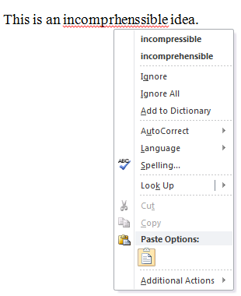
Distances between strings
What’s wrong with this picture?
The distance is context insensitive
Ideas cannot be incompressible, so suggest the second first…

Slide 15
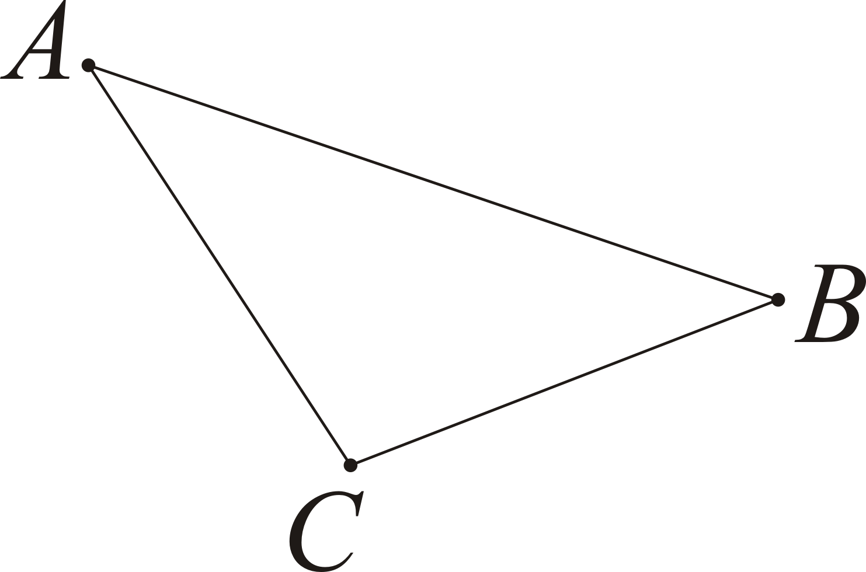
Distances between strings
Recall the properties of the Euclidean distance:
dist( A, B ) ≥ 0
dist( A, B ) = 0 if and only if A = B
dist( A, B ) = dist( B, A )
dist( A, B ) ≤ dist( A, C ) + dist( C, A )
All of these properties hold for the Levenshtein distance between strings

Slide 16
Strings in other alphabets
Other alphabets include:
Morse code uses five characters:
dot
dash
inter-character space
inter-word space
inter-sentence space
Note: “SOS” is · · · - - - · · · while the mayday sos is · · · - - - · · ·
inter-character spaces

Slide 17
Strings in other alphabets
Western European alphabets often include additional characters on top of ascii; however, Unicode allows for most alphabets
German | ABCDEFGHIJKLMNOPQRSTUVWXYZÄÖÜß
Swedish | ABCDEFGHIJKLMNOPQRSTUVWXYZÅÄÖ
Italian | ABCDEFGHILMNOPRSTUVZ
Slovenian | ABCČDEFGHIJKLMNOPRSŠTUVZŽ
Polish | AĄBCĆDEĘFGHIJKLŁMNŃOÓPQRSŚTUWXYZŹŻ
Greek | ΑΒΓΔΕΖΗΘΙΚΛΜΝΞΟΠΡΣΤΥΦΧΨΩ
Russian | АБВГДЕЁЖЗИЙКЛМНОПРСТУФХЦЧШЩъыьЭЮ Я
Persian | ا ب پ ت ث ج چ ح خ د ذ ر ز ژ س ش ص ض ط ظ ع غ ف ق ک گ ل م ن و ه ی
Gurmukhi | ੳਅੲਸਹਕਖਗਘਙਚਛਜਝਞਟਠਡਢਣਤਥਦਧਨਪਫਬਭਮਯਰਲਵੜ

Slide 18
Strings in nature
Even better, deoxyribonucleic acid (dna) is a string with a four-characters alphabet:
cytosine C
guanine G
adenine A
thymine T
All the algorithms developed by computer scientists for analyzing and manipulating strings were immediately transferable to the analysis and manipulation of dna
This is one of the beauties of abstraction

Slide 19
Summary
Following this lesson, you now
Know that strings are sequences of characters
Those characters come from a fixed alphabet
Know the most primitive means of storing strings are null-character-terminated arrays of char
Understand how to calculate the length of a string
Understand string distances
Are aware that
Simple strings are limited to ascii
Other languages require Unicode

Slide 20
References
[1] No references?

Slide 21



Colophon
These slides were prepared using the Georgia typeface. Mathematical equations use Times New Roman, and source code is presented using Consolas.
The photographs of lilacs in bloom appearing on the title slide and accenting the top of each other slide were taken at the Royal Botanical Gardens on May 27, 2018 by Douglas Wilhelm Harder. Please see
https://www.rbg.ca/
for more information.

Slide 22
Disclaimer
These slides are provided for the ece 150 Fundamentals of Programming course taught at the University of Waterloo. The material in it reflects the authors’ best judgment in light of the information available to them at the time of preparation. Any reliance on these course slides by any party for any other purpose are the responsibility of such parties. The authors accept no responsibility for damages, if any, suffered by any party as a s_result of decisions made or actions based on these course slides for any other purpose than that for which it was intended.

